Slide 1

Zomato
RESTAURANT Analysis
Chhaya Porwal
03/10/2026

Slide 2
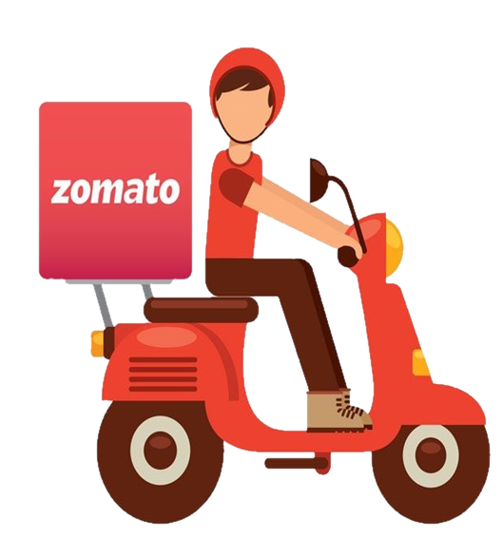
About ZOMATO
Zomato is a food-tech platform that helps people discover restaurants, order food online and book tables. In FY2025 the listed parent company was renamed Eternal Limited, and Zomato continues as its flagship consumer brand, alongside Blinkit (quick commerce), District (going out) and Hyperpure (restaurant supplies). In Q1 FY27, Zomato's food delivery served 27.2 million average monthly transacting customers and worked with more than 3.28 lakh (328,000) active restaurant partners. In FY2025, it processed 853 million orders, with 20.6 million monthly transacting customers and about 297,000 active restaurant partners.
Key figures:
Monthly transacting customers: 27.2 million in Q1 FY27, up 18.77% from 22.9 million in Q1 FY26.
Active restaurant partners: over 3.28 lakh (328,000) in Q1 FY27.
Food orders: 853 million in FY2025.
Company revenue: ₹20,211 crore in Q1 FY27, of which food delivery contributed ₹3,100 crore (about 15.3%).
Blinkit: 2,443 stores after adding 200 net new stores in Q1 FY2

Slide 3
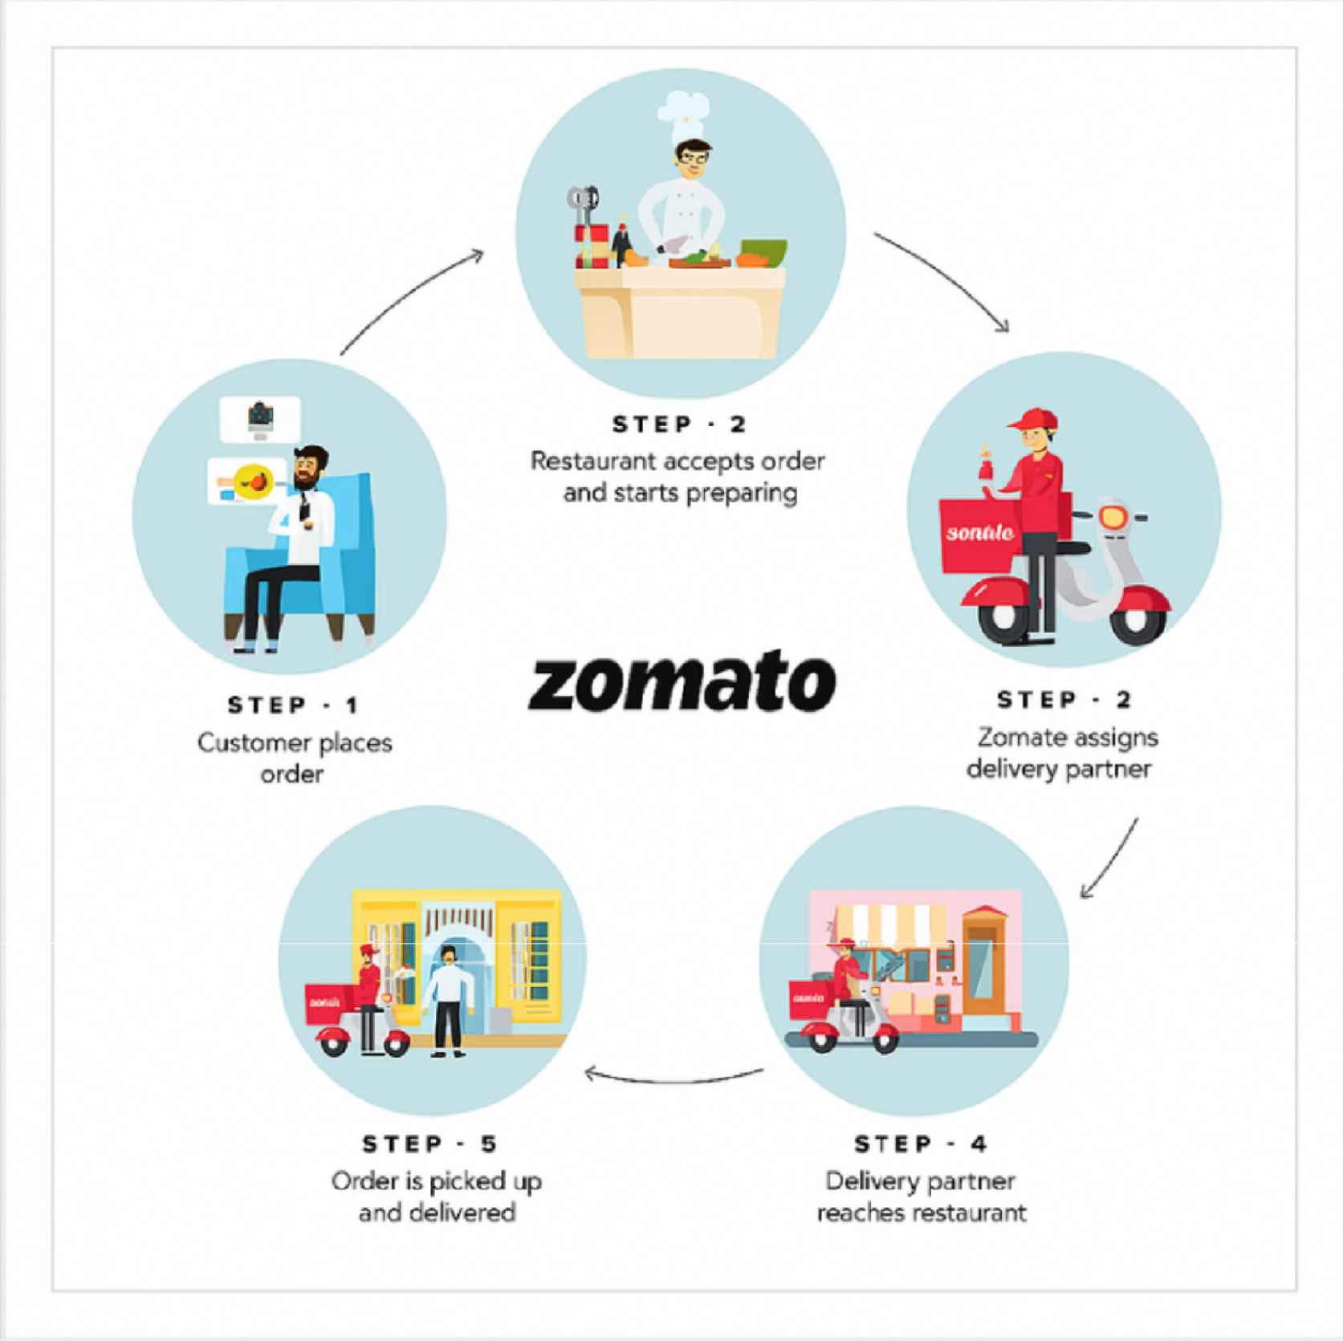
How Zomato Works
Zomato works by connecting users with
restaurants through an easy-to-use platform where they can search for eateries based on location, cuisine, ratings, or price. Users can
explore menus, read reviews, view photos, and either place orders for delivery or book tables directly. At the same time, restaurants use
Zomato to manage their profiles, update menus, respond to customer feedback, and access performance insights. This two-way system helps users enjoy a smooth food discovery and ordering experience while enabling restaurants to grow and serve their customers better.

Slide 4
Agenda
Problem
Statement
Key Observation
Strategic Recommendations & Dashboard
Data Overview & Preparation
Key Metrics &
Visualizations
Conclusion

Slide 5
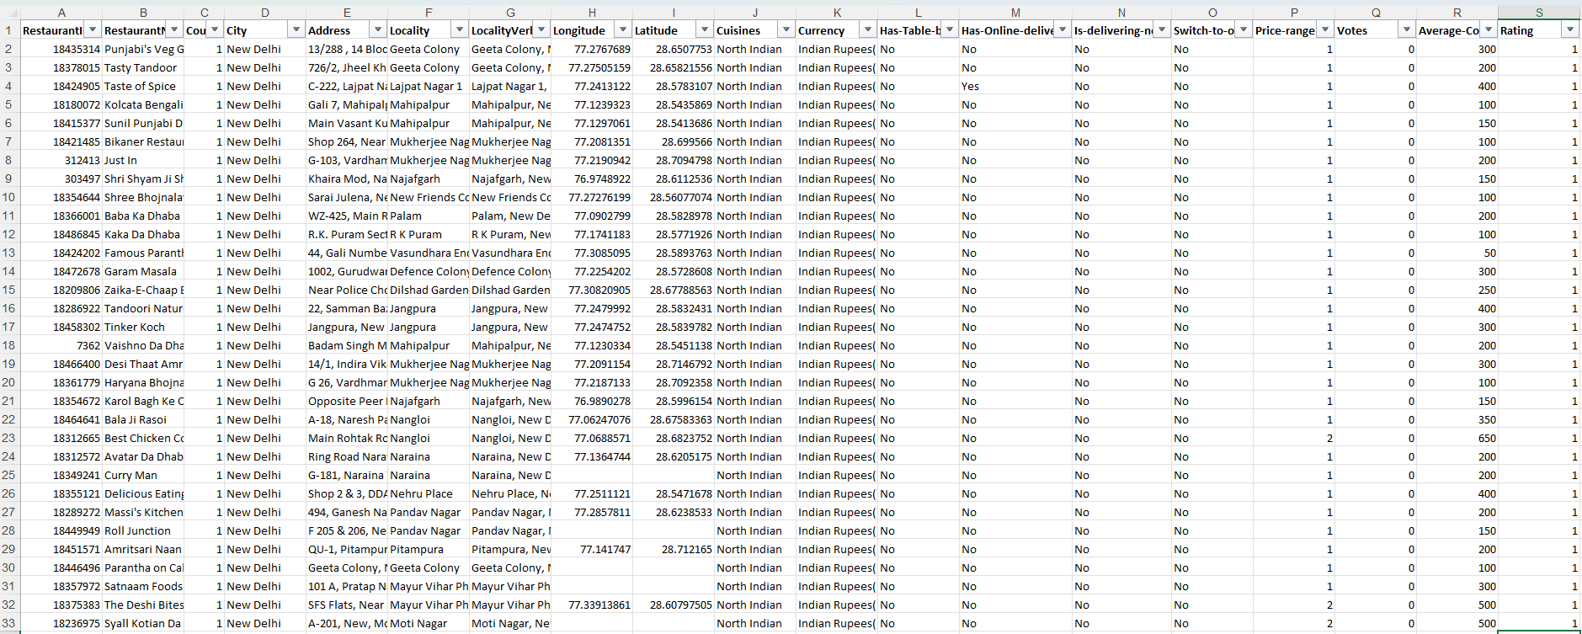
Zomato Problem Statement
You are hired as a consultant data analyst by Zomato where the team is looking for expansion and opening restaurants. Your task is to come up with strategies/suggestions about opening newer restaurants.

Slide 6
Zomato Data Overview
The dataset includes details for 9,551 restaurants, with 20 columns capturing various attributes of each establishment.
Here's a brief overview of the information available in the dataset:
Has_Table_booking: Indicates whether the restaurant has a table booking option (Yes/No).
Has_Online_delivery: Indicates whether the restaurant offers online delivery (Yes/No).
Is_delivering_now: Indicates whether the restaurant is currently delivering (Yes/No).
Switch_to_order_menu: Indicates whether users can switch to
the order menu (Yes/No).
Price_range: A numeric value indicating the price range category
of the restaurant.
Votes: The number of votes or ratings/(feedback) received by the restaurant.
Average_Cost_for_two: The average cost for two people dining
at the restaurant.
Rating: The overall rating of the restaurant is based on user reviews.
Datekey_opening: The date when the restaurant was opened.
Restaurant ID: Unique identifier for each restaurant.
Restaurant Name: The name of the restaurant.
CountryCode: Country code of the location where the restaurant is situated.
City: The city where the restaurant is located.
Address: The specific address of the restaurant.
Locality: The locality or neighborhood where the restaurant is situated.
Locality Verbose: Detailed information about the locality.
Longitude: The geographical longitude coordinate of the restaurant.
Latitude: The geographical latitude coordinate of the
restaurant.
Cuisines: The type of cuisine offered by the restaurant.
Currency: The currency used for transactions in the restaurant.

Slide 7
Zomato Data Snapshot & Data Preparation
Total Number of Restaurants: From 2010 to 2018, 9,551 restaurants were established across 15 countries.
Number of Cities: The data covers 141 cities with a wide variety of restaurants.
Variety of Cuisines: There are 1,825 different cuisine combinations, including popular choices like Italian, Mexican, Chinese, Indian and American. Each cuisine adds its own flavors, ingredients and cooking methods to the diverse world of food.
Ratings: The average restaurant rating is 2.9, which gives an idea of how the restaurants perform overall.
Online Services: The data shows whether each restaurant offers table booking, online delivery and current delivery status.
Data Cleaning:
Removed Missing Values: Rows with missing values in the Cuisines column were removed so the data is complete and suitable for analysis.
Trimmed Extra Spaces: Unwanted spaces were trimmed from the Address, Locality and Locality Verbose columns to keep the data uniform and prevent errors in grouping or filtering.
Filled Missing Cost Values: Missing entries in the Average Cost for Two column were filled with the median value for the same Price Range, to keep the pricing data consistent.
Converted Strings to Date Format: The Datekey_Opening column, originally stored as text, was converted into a proper date format to allow accurate date-based analysis.
Data Pre-Processing:
Extracted Year and Month: New Year and Month columns were created from the formatted date column to support time-based insights and trend analysis.
Mapped Country Names: Country names were added by mapping each Country Code to a reference table using VLOOKUP, which improves the geographic understanding of the data.
Standardized Currency: All values in Average Cost for Two were converted to INR, and a new column, Average_Cost_for_Two_INR, was created so restaurants can be grouped into cost ranges for easier comparison.

Slide 8
Analytical Approaches and Tools
The analysis was carried out using the following methods and tools:
Data Cleaning: I used functions like TRIM to remove extra spaces and Conditional Formatting to highlight inconsistencies. I also removed rows with missing values to keep the dataset clean and reliable.
Data Enrichment: I used the TEXT function to extract date components such as year and month, and VLOOKUP to add columns such as country names, which gives the dataset more clarity and context.
Descriptive Analysis: I used Pivot Tables to break down the data by country, cuisine, price and rating. This helped me identify key trends and compare different aspects of restaurant performance.
Visualization: I created different types of charts to show the data visually, which made it easier to spot patterns, compare values and share insights clearly.

Slide 9
Objective Analysis: Key Metrics and Visualizations

Slide 10
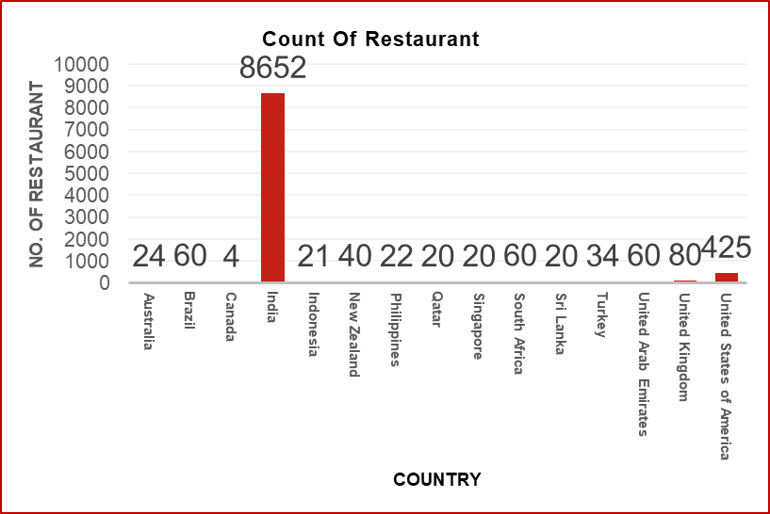
Number of Restaurants Opened in Each Country
The analysis was carried out using the following methods and tools:
India has the most restaurants (8,652), followed by the United States, so competition is highest in these two countries.
Canada has the fewest restaurants (4).
Most other countries have between 20 and 80 restaurants.
This graph helps management decide where to open new restaurants and which countries have more room to grow, by showing which countries are crowded and which are not.

Slide 11
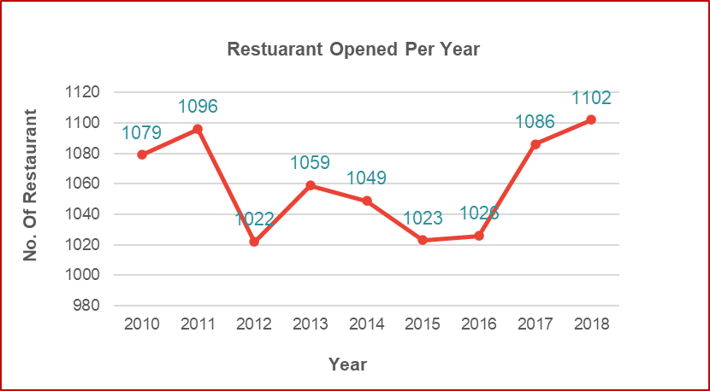
Number of Restaurants Opened in Each Year
In 2018, the highest number of restaurants was opened (1,102).
2012 had the lowest number of openings (1,022).
From 2010 to 2018, openings stayed between about 1,020 and 1,100 per year. They dipped in 2012, fell to a low in 2015 and 2016, and rose again in 2017 and 2018.
This trend can help future analysis check whether the pattern of restaurant openings changes.

Slide 12
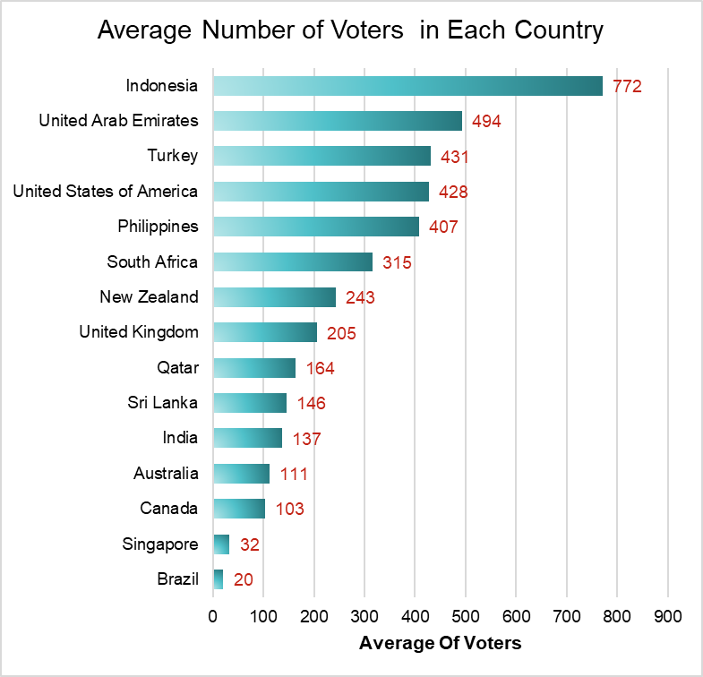
Average Number of Votes in Each Country
The number of votes gives an idea of customer engagement in restaurants across different countries.
Indonesia has the highest average number of votes (772), which suggests more customer activity and feedback.
Brazil (20) and Singapore (32) have the lowest average votes, which suggests relatively lower customer interaction.

Slide 13
Insightful Observations

Slide 14
Suggested Countries Having Less Competition
To find the best countries for expansion, I looked for markets with fewer restaurants but good customer engagement. The aim was to find less crowded markets that still show strong potential, using demand signals such as the number of votes.
CANADA
AUSTRALIA
SRILANKA
SINGAPORE
4
Restaurants
3.6
Avg. Rating
24
Restaurants
3.7
Avg. Rating
20
Restaurants
3.9
Avg. Rating
20
Restaurants
3.6
Avg. Rating
Only 4 restaurants in 4 cities, so there is plenty of room to grow.
Ratings are relatively low (3.6), so a better-quality restaurant can make a real difference.
Expand carefully into new cities and focusing on quality to gain a competitive edge.
24 restaurants spread across 23 cities, so supply is clearly limited.
Ratings are below average (3.7), leaving room to improve the dining experience.
The market is thinly served, so careful expansion can meet demand.
The Market is largely untapped, giving a real chance to build a strong presence.
Customers are interested, but there is room to raise quality and stand out.
Expanding beyond Colombo to capture growing demand and build lasting loyalty.
Only 4 restaurants are listed, indicating potentially limited competition.
Average rating is 3.6, suggesting opportunities to improve food quality and customer experience.
Focus on premium dining and better service to attract customers and build a competitive advantage.

Slide 15
Suggested Countries Having High Market Potential
To find the best countries for expansion, I looked for markets with fewer restaurants but good customer engagement. The aim was to find less crowded markets that still show strong potential, using demand signals such as the number of votes.
INDONESIA
PHILIPPINES
QATAR
21
Restaurants
4.3
Avg. Rating
22
Restaurants
4.5
Avg. Rating
20
Restaurants
4.06
Avg. Rating
Indonesia shows strong customer interest, with a 4.3 rating and 772 votes.
Only 21 restaurants in 4 cities point to low competition and limited reach.
This makes Indonesia a strategic choice for early expansion, letting us to meet existing demand and grow ahead of competitors.
The country has a solid 4.5 average rating, which shows customers enjoy what is on offer.
Despite interest across 9 cities, there are only 22 restaurants, so the overall presence still feels minimal.
This indicates a clear gap between demand and availability, so it is a good time to deepen our presence in existing cities and scale further.
Only 20 restaurants are listed, suggesting a relatively limited restaurant supply in the dataset.
Average rating is 4.06, indicating positive customer experiences.
Focus on expanding into promising locations with quality dining options to attract customers and build a strong market presence.

Slide 16
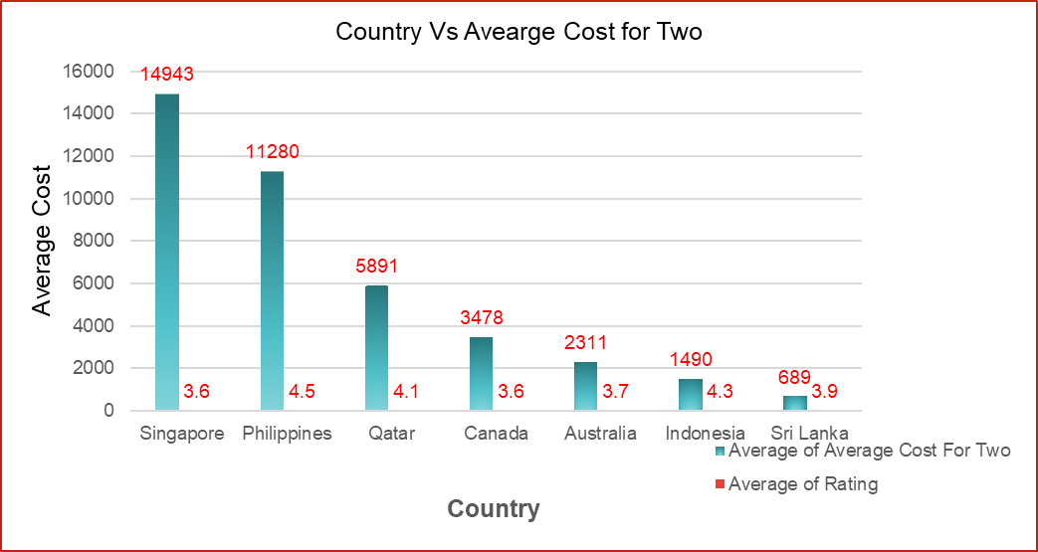
Food Expenditure Trends In The Suggested Countries
To understand how people spend on dining, I compared the average cost for two across all the suggested countries. This shows how affordable each market is and how customers spend, which helps shape our pricing and restaurant setup.
Singapore: Spending is the highest of all countries at about INR 14,943 for two, well above the overall average of 5,949. This suits premium and fine-dining outlets. The rating is only 3.6, so quality and service can set a new restaurant apart.
Qatar: Spending is upper-mid range at about INR 5,891, almost exactly the overall average. Customers also rate it highly (4.1), so a well-priced, quality-focused restaurant can attract steady demand without a luxury budget.

Slide 17
Food Expenditure Trends In The Suggested Countries
Sri Lanka: Average cost for two is approximately ₹689, indicating an opportunity to explore affordable, value-for-money restaurant concepts.
Indonesia: Average cost for two is approximately ₹1,490, supporting exploration of budget-friendly restaurants with a focus on food quality.
Australia: Average cost for two is approximately ₹2,311. Mid-range restaurants can focus on quality food and competitive pricing.
Canada: Average cost for two is approximately ₹3,478. Restaurants can explore mid-range dining with an emphasis on service quality and customer satisfaction.
Philippines: Average cost for two is approximately ₹11,280, suggesting relatively high dining expenditure in the dataset. Premium restaurant concepts may be worth evaluating in suitable urban locations.

Slide 18
Cuisines To Focus In Newer Restaurants
To decide which cuisines to focus on in new restaurants, I looked at two key measures: average rating, which reflects customer satisfaction, and total votes, which show popularity. This helped identify cuisines that perform well and have real demand.
ANALYSIS:
Australia: Mediterranean, Seafood, and Pizza are cuisine options to evaluate based on the existing cuisine analysis.
Canada: Italian, Mediterranean, and Pizza have average ratings of approximately 4.3 in the current analysis.
Indonesia: Japanese/Sushi, Indonesian cuisine, and local food options are candidates to evaluate based on ratings and customer votes.
Philippines: Filipino, Mexican, and Seafood are cuisine options identified in the current analysis.
Sri Lanka: Seafood, Juices, and Desserts are options to consider, with several cuisine categories showing ratings above 4.2.
Singapore: Explore Japanese, Italian, and Seafood concepts as proposed options; verify their country-specific ratings and votes in Excel.
Qatar: Explore Middle Eastern, Indian, and Seafood concepts as proposed options; verify their country-specific ratings and votes in Excel.

Slide 19
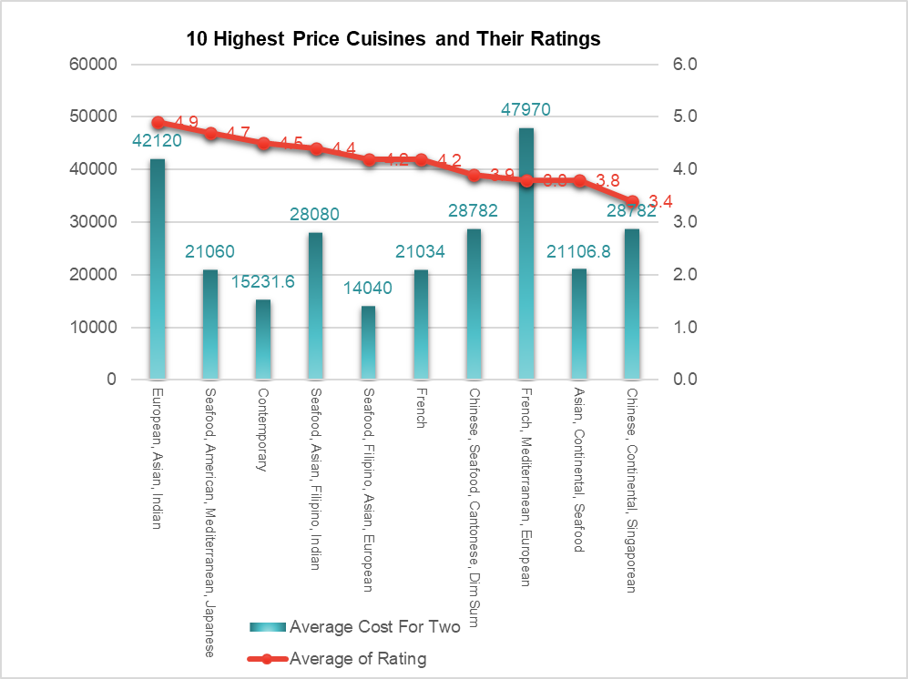
Cuisine Recommendations for Suggested Countries
Choosing the right cuisines is key to restaurant performance. In our seven suggested countries (Australia, Canada, Indonesia, the Philippines ,Qatar, Singapore and Sri Lanka), certain cuisines consistently earn higher ratings and more votes, which makes them ideal for new restaurants.
RECOMMENDATION:
Australia: Evaluate Bar Food and Australian cuisine. These have average ratings of approximately 4.0, based on 3 and 4 restaurants respectively. Pizza/Bar Food and Mediterranean/Seafood combinations also received ratings of 4.6 and 4.4.
Canada: Consider Italian, Mediterranean, and Pizza as a niche opportunity. The combination scored 4.3 with 204 votes, but this is based on only one restaurant, so further validation is required.
Indonesia: Prioritize Indonesian and Sunda cuisine, with average ratings of 4.51 and 4.90. Japanese/Sushi is another promising option, with ratings above 4.6 and strong vote counts.

Slide 20
Cuisine Recommendations for Suggested Countries
RECOMMENDATION:
Philippines: Prioritize Japanese, Mexican, Filipino, and Seafood. These cuisines show average ratings of approximately 4.4–4.9, with multiple restaurants and meaningful customer votes.
Sri Lanka: Prioritize Seafood, followed by Desserts. Their average ratings are approximately 4.37 and 4.12. Juices could be tested alongside Desserts, but the evidence is limited.
Singapore: Bakery and Italian are options for further testing, with average ratings of 4.2 and 4.1. However, their vote counts are low, so the data does not establish strong demand.
Qatar: Evaluate Chinese and Indian cuisine. Chinese averages approximately 4.23 across 3 restaurants, while Indian averages 4.04 across 7 restaurants and has a larger combined vote count.

Slide 21
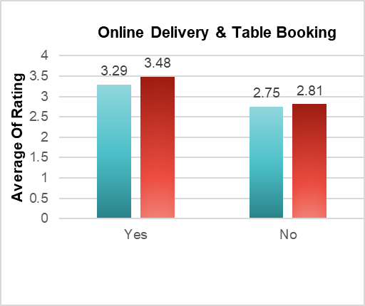
Online Delivery And Table Booking Services
This analysis compares average restaurant ratings based on the availability of online delivery and table booking. Restaurants offering these services have higher average ratings in the analyzed dataset.
INSIGHTS:
Restaurants with online delivery have an average rating of 3.29, against 2.75 for those without.
Restaurants with table booking have an average rating of 3.48, against 2.81 for those without.
Both services go with higher ratings, and table booking shows the bigger gap (0.67, against 0.54 for online delivery).
This suggests that offering these services in our suggested countries could help improve customer satisfaction.

Slide 22
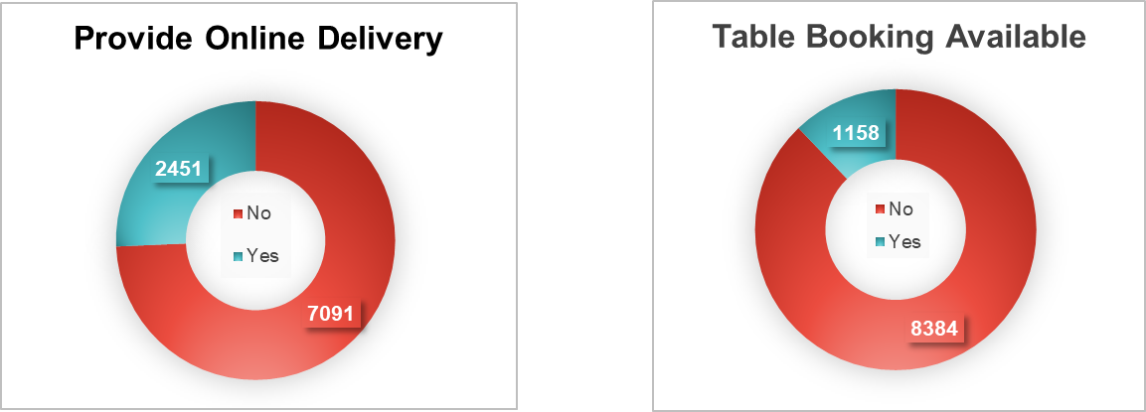
Online Delivery And Table Booking Services
RECOMMENDATION:
Address the service gap: Only 25.7% of restaurants offer online delivery, while 12.1% offer table booking. Evaluate Introducing these services in the selected target markets.
Set a launch target: Plan to offer online delivery and table booking available from launch, subject to local demand and operational feasibility.
Improve customer experience: Restaurants offering these services have higher average ratings in the analyzed dataset. Monitor customer feedback and set a target rating of 4.5/5 within six months.
Measure business impact: Track monthly orders, table bookings, repeat-customer rate, and average ratings. Compare results with the first month's baseline to evaluate service performance.
No. of Restaurants | Provide Online Delivery
Yes | 2451
No | 7091
No. of Restaurants | Table Booking Available
Yes | 1158
No | 8384

Slide 23
Suggestions
Based on al l the insights gathered, I created an interactive dashboard featuring key charts and added slicers for countries and years to make data visualization more dynamic and easier to explore.
STRATEGIC SUGGESTIONS:
Prioritize expansion markets: Start with Indonesia and the Philippines, followed by Sri Lanka, based on the country-level findings. Validate demand through pilot launches before expanding.
Test Australia and Canada: Launch one pilot restaurant in each market and evaluate demand, operating costs, and profitability over 3–6 months.
Select promising cities: Evaluate Bandung and Bogor in Indonesia, Quezon City and Tagaytay City in the Philippines, and Colombo in Sri Lanka based on local demand and competition.
Set a rating target: Aim for an average customer rating above 4.5/5 within six months. Monitor ratings monthly and address recurring complaints.

Slide 24
Suggestions
Based on al l the insights gathered, I created an interactive dashboard featuring key charts and added slicers for countries and years to make data visualization more dynamic and easier to explore.
OPERATIONAL SUGGESTIONS:
Offer both services: Provide online delivery and table booking from launch. Track adoption, orders, and bookings monthly.
Focus on popular cuisines: Test Japanese/Sushi, Seafood, and local food options. Compare order volumes and ratings to identify the best performers.
Review weaker cuisine combinations: Evaluate North Indian/Chinese combinations using customer ratings and order demand before investing further.
Adapt pricing by market: Test value pricing in Sri Lanka and Indonesia and premium offerings in the Philippines. Monitor average order value, sales volume, and profit margin.
Use performance-based expansion: Review orders, customer ratings, repeat-customer rate, and profitability monthly. Expand only when predefined targets are achieved.

Slide 25
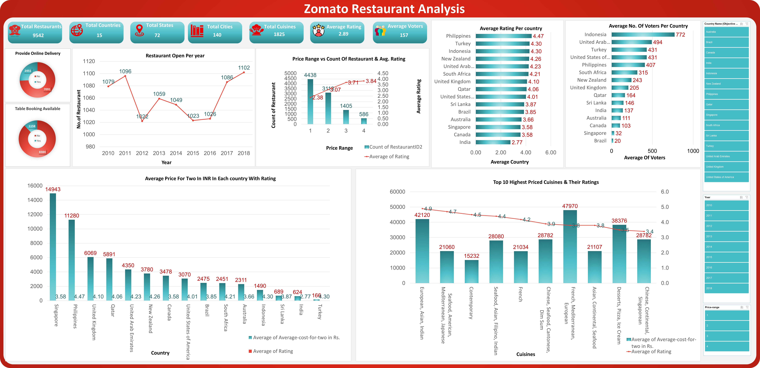
Dashboard
Based on al l the insights gathered, I created an interactive dashboard featuring key charts and added slicers for countries and years to make data visualization more dynamic and easier to explore.

Slide 26
Conclusion
The analysis of 9,551 Zomato restaurants across 15 countries shows that the best opportunities for new restaurants are in markets with few restaurants but good ratings and customer interest, not in the biggest markets.
Market size: India has 8,652 of the 9,551 restaurants (about 91%), and the USA has 434, so both are crowded. Most other countries have only 4 to 80 restaurants.
Best countries: Indonesia (21 restaurants, 4.3 rating, 772 average votes) and the Philippines (22 restaurants, 4.5 rating, 407 average votes) have low competition and high demand. Sri Lanka (20 restaurants, 3.9 rating) is a good next step. Australia and Canada should start with one pilot restaurant each.
Cities: Jakarta has 16 of Indonesia's 21 restaurants, and all of Sri Lanka's 20 are in Colombo. Smaller cities such as Bandung, Bogor, Quezon City and Tagaytay City have less competition.
Cuisines: Cuisine affects ratings. Japanese/Sushi, Seafood, desserts and local cuisines rate well, while mixed categories like North Indian/Chinese rate low in some markets.
Services: Restaurants with online delivery (3.29 vs 2.75) and table booking (3.48 vs 2.81) have higher average ratings, yet only about 26% and 12% of restaurants offer them.
Pricing: Spending is lowest in Sri Lanka and Indonesia and much higher in the Philippines, so pricing should be set for each market.

Slide 27
THANK YOU

